Slide 1




PES's Modern College of Engineering, Pune-05
Department of Electronics and Computer Engineering
AICTE Idea Lab
EnerGenius
Ultra-Low-Power Embedded System Development using MSPM0+
Faculty Coordinators
Dr. Mrs.V. P. Kodgirwar Mr. A.R. Gangajaliwale
1
Notes:
1.7.2013
1
‹#›

Slide 2
Topic: Autonomous EV Wireless Charging and Magnetic Alignment
Problem Statement 1
Discription:
Wireless Power Transfer (WPT) efficiency in electric vehicles decreases
when the transmitter and receiver coils are misaligned.
The aim of this project is to develop a closed-loop system that uses 3D
magnetic sensor to detect the magnetic field, automatically adjusts
the coil alignment using a servo motor, and monitors voltage, current
and power to evaluate charging performance.
Notes:
1.7.2013
‹#›

Slide 3
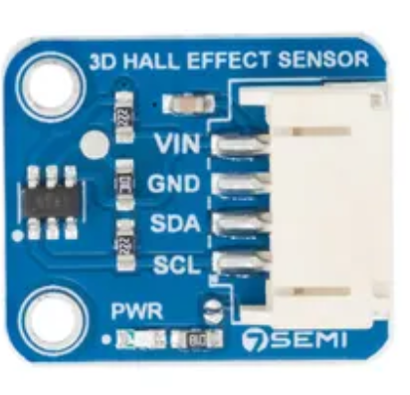
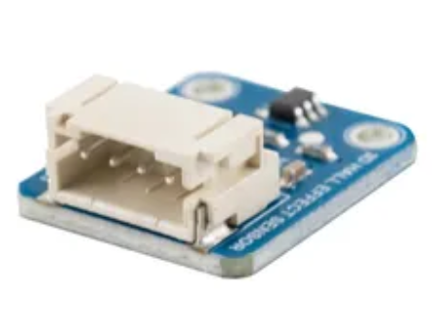
TMAG5273 – 3D Hall-Effect Magnetic Sensor
    Supply Voltage: 1.7 V to 3.6 V
    Magnetic Axes: X, Y, and Z
    Interface: I²C communication.
    Controller: MSPM0H3216 LaunchPad.
    Output: Three-axis magnetic field measurements.
    Measurement Function: Detects magnetic-field strength and direction along three axes
    Application: Magnetic position detection and automatic alignment.
    The sensor provides magnetic field measurements that the microcontroller processes to estimate the alignment error.
Notes:
1.7.2013
‹#›

Slide 4
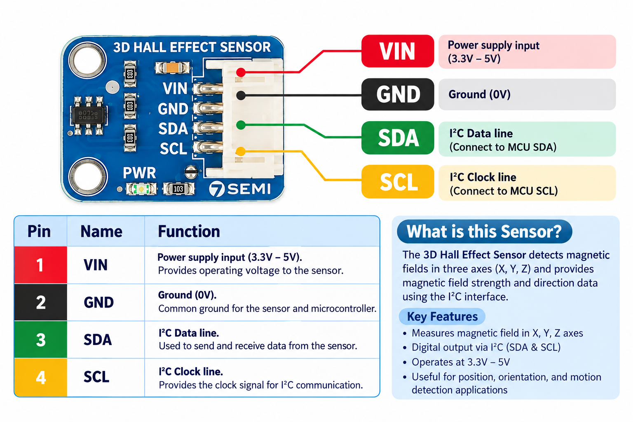
TMAG5273 – 3D Hall-Effect Magnetic Sensor
Notes:
1.7.2013
‹#›

Slide 5
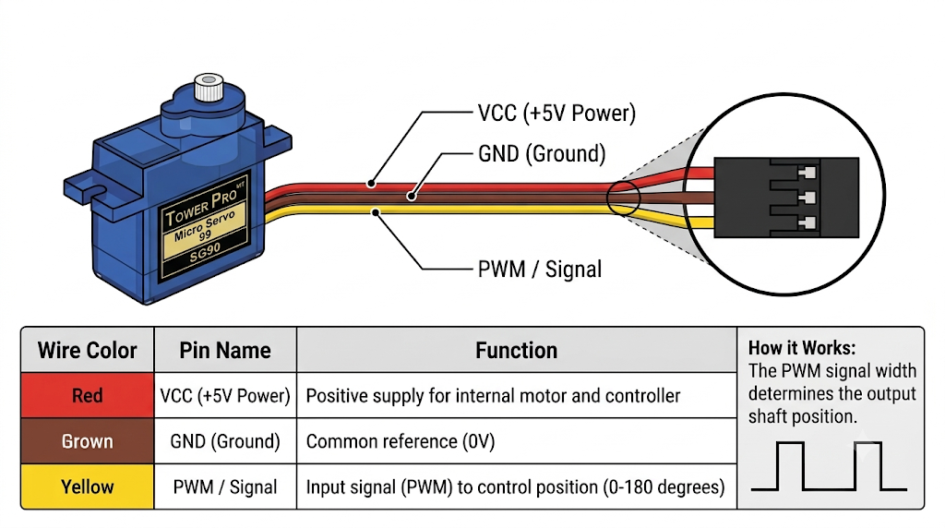
SG-90 Servo Motor Overview

Slide 6
Working of TMAG5273 Sensor
The TMAG5273 uses the Hall-effect principle to measure magnetic fields.
    A magnetic pilot beacon is placed near the charging pad.
    The TMAG5273 detects the magnetic field generated by the beacon.
    It measures the magnetic field components along the X, Y and Z axes.
    The sensor sends these measurements to the MSPM0H3216 through I²C.
    The microcontroller processes the readings to estimate the direction and magnitude of misalignment.
    Note: Converting magnetic field readings into actual coil displacement requires calibration and a known magnetic-field arrangement.
Notes:
1.7.2013
‹#›

Slide 7

Internal Working of TMAG5273
Step-by-Step Magnetic Alignment
Main Functional Blocks
    Hall-Effect Sensing Elements: Detect magnetic fields along
three axes.
    Signal Processing Circuit: Processes the sensor signals.
    Analog-to-Digital Conversion: Converts measured signals into digital values.
    Control and Configuration Registers: Allow the microcontroller to configure sensor operation.
    I²C Interface: Transfers magnetic field data to the controller.
    The digital measurements are used to determine whether the receiver coil needs positional correction.
Notes:
1.7.2013
‹#›

Slide 8
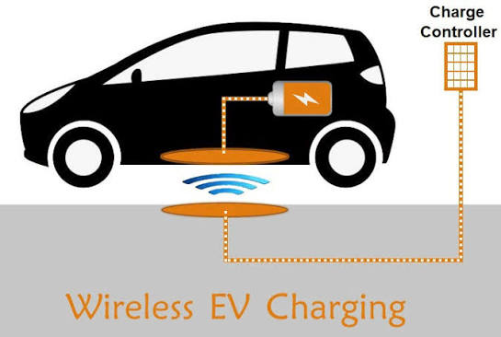
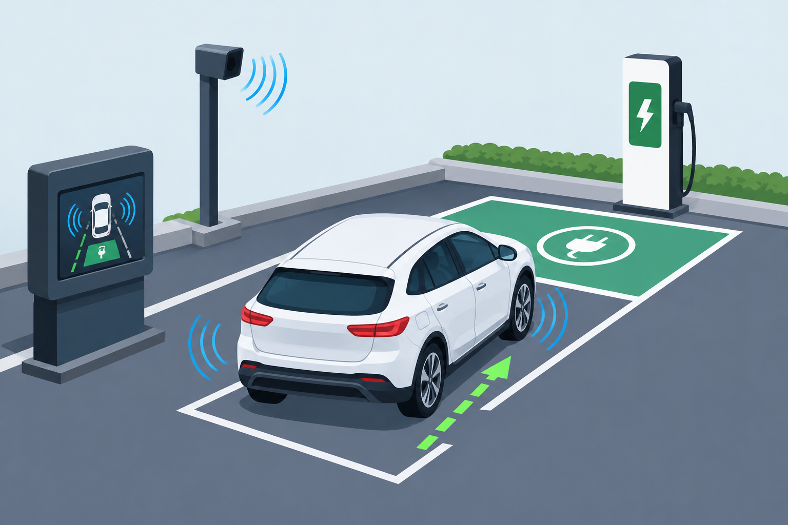
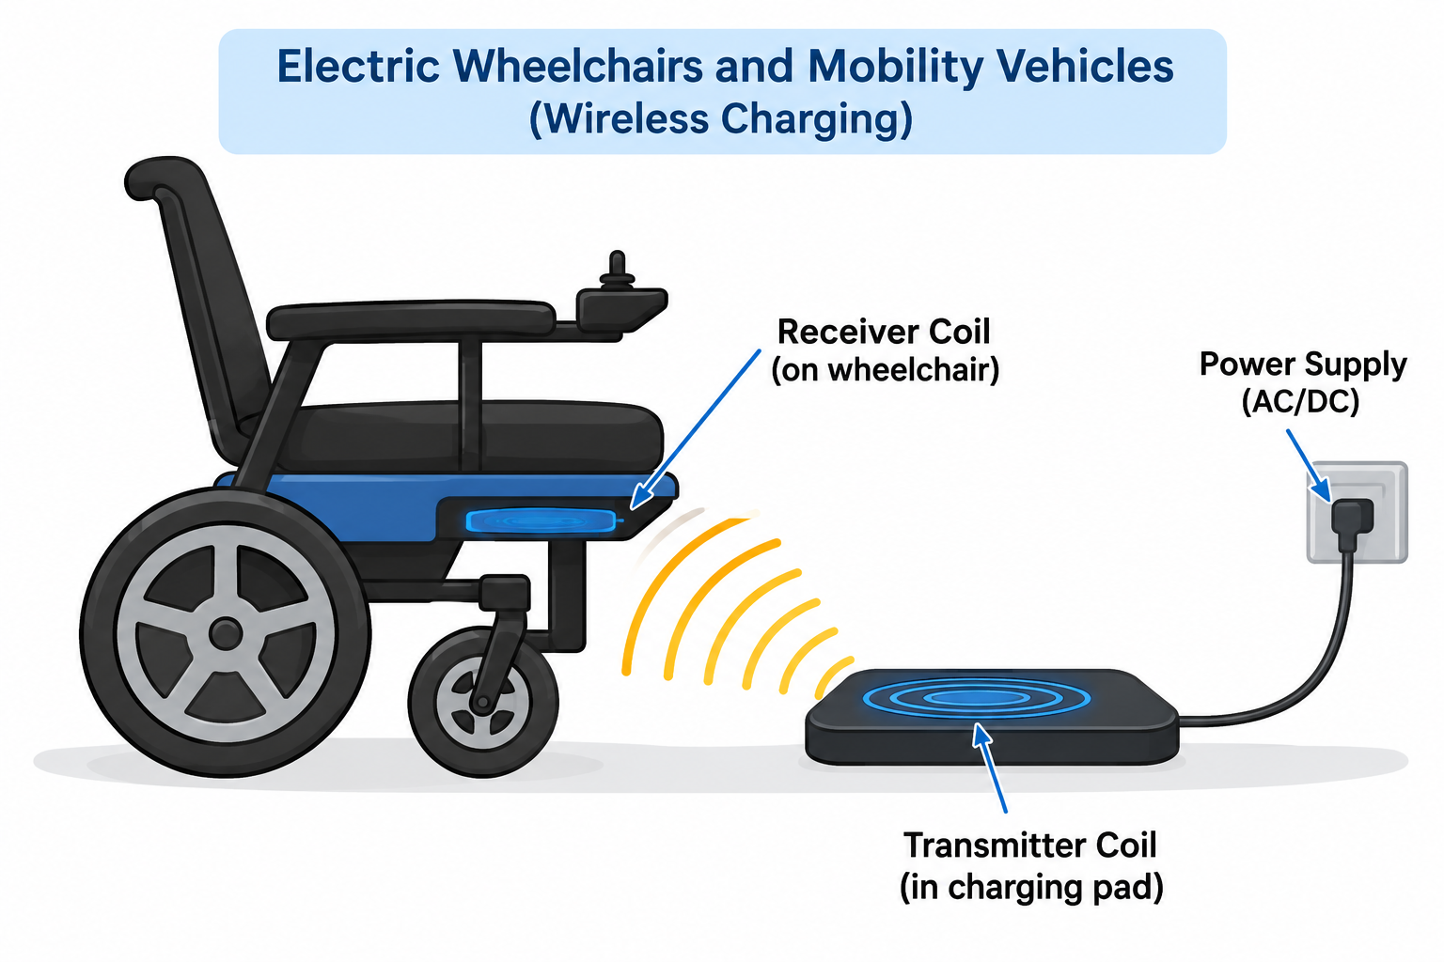
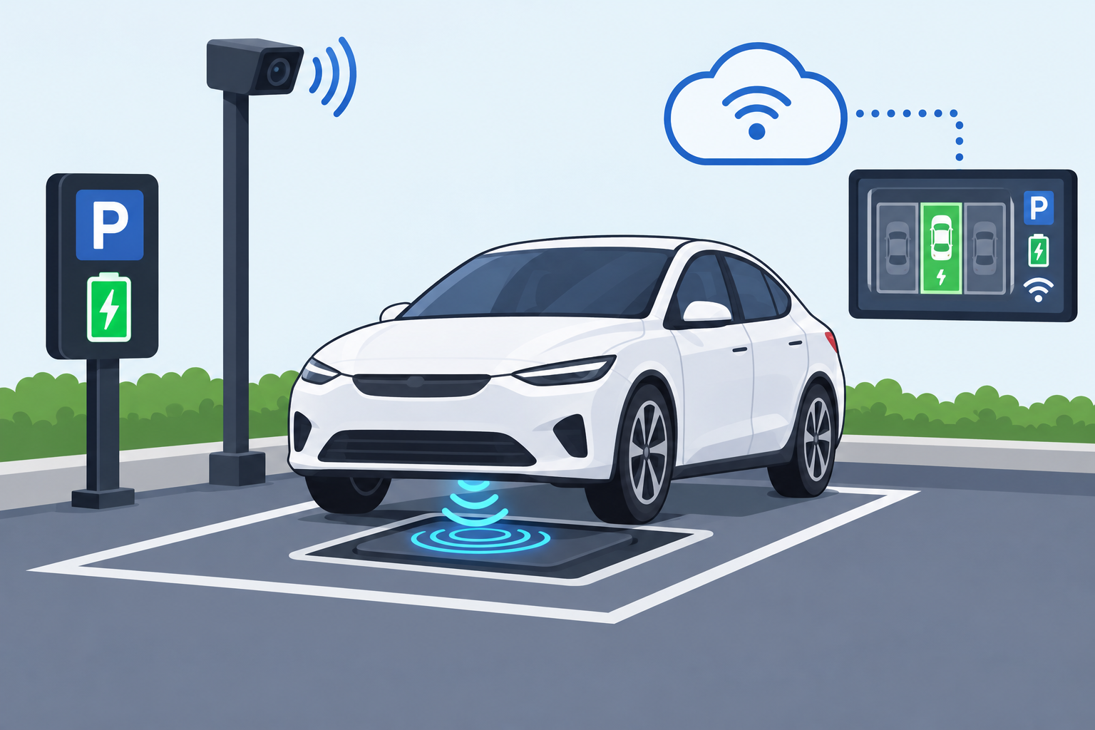
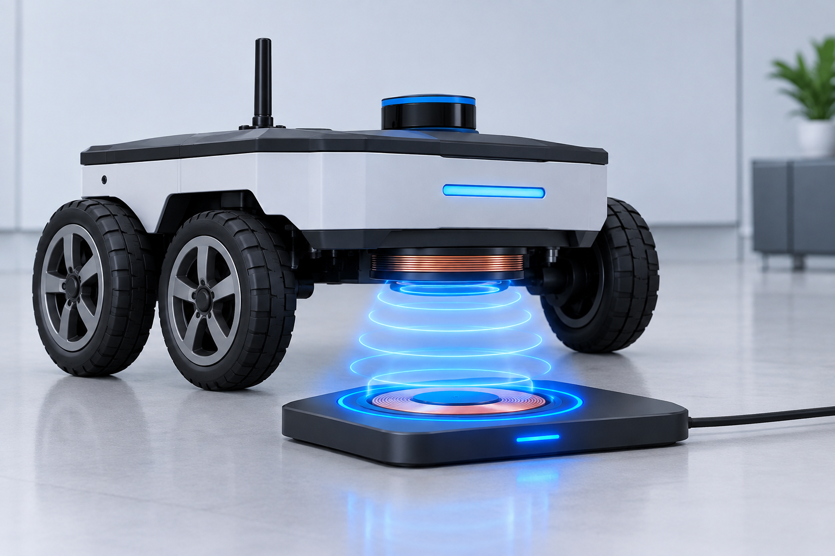

Applications of the Proposed Wireless Charging Alignment System
Electric Vehicle Wireless Charging
Automatic Parking for Charging
Electric Wheelchairs and Mobility Vehicles
Smart Parking Systems
Robotic Wireless Charging
Fleet and Public EV Charging
Notes:
1.7.2013
‹#›

Slide 9
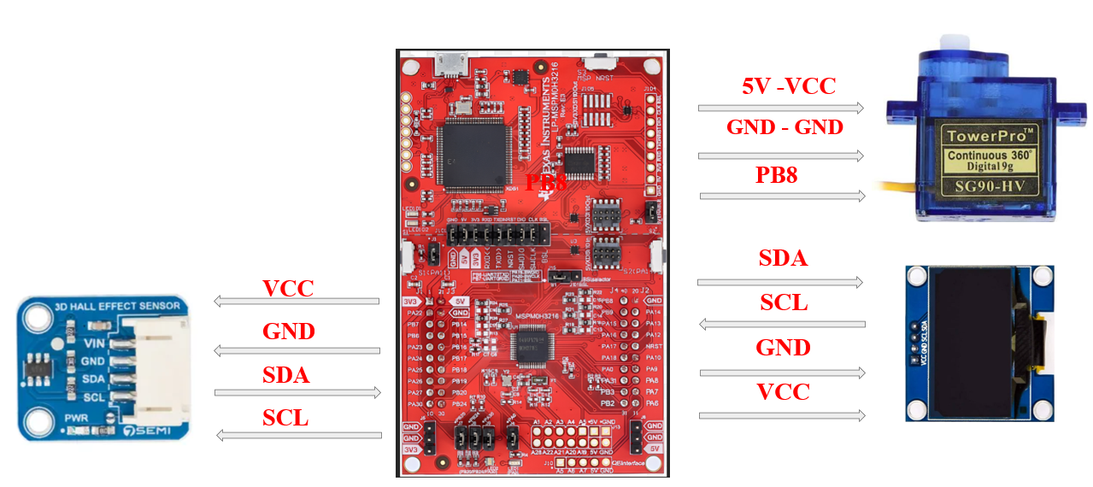
Pin connections Overview

Slide 10
Thought process to write code - Algorithm
  Initialize all hardware: Configure the MCU, I²C communication, OLED, TMAG5273 Hall sensor, and servo.
  Set the servo to the center position: Move the servo to 90° so that the system starts from a known mechanical position.
  Calibrate the target position: Keep the system at the desired alignment position and take 64 Hall-sensor X readings. Calculate their average and store it as targetX.
  Read and filter sensor data: Continuously read X, Y, and Z from the TMAG5273 and use a 16-sample average filter to reduce fluctuations.
  Calculate alignment error: Compare the filtered X value with targetX. If the error is large, calculate a small servo movement; if it is within the alignment range, consider the system aligned.
  Monitor and display the system: Display X, Y, Z, servo angle and alignment status on the OLED.

Slide 11
#include "ti_msp_dl_config.h"
#include <stdint.h>
/* I2C Addresses */
#define OLED_ADDRESS 0x3C
#define TMAG_ADDRESS 0x35
#define INA219_ADDRESS 0x40
/* TMAG5273 Registers */
#define TMAG_DEVICE_CONFIG_1 0x00
#define TMAG_DEVICE_CONFIG_2 0x01
#define TMAG_SENSOR_CONFIG_1 0x02
#define TMAG_SENSOR_CONFIG_2 0x03
/* Servo */
#define SERVO_PERIOD 20000
define SERVO_MIN_ANGLE 10
#define SERVO_MAX_ANGLE 170
#define SERVO_CENTER_ANGLE 90
/* Alignment */
#define ALIGN_LIMIT 80
#define SERVO_ERROR_DIV 300
#define SERVO_MAX_STEP 3
/* Filter */
#define FILTER_SAMPLES 16
/* Variables */
int16_t targetX = 0;
int16_t servoAngle = 90;
uint8_t aligned = 0;
int32_t xBuffer[FILTER_SAMPLES];
int32_t yBuffer[FILTER_SAMPLES];
int32_t zBuffer[FILTER_SAMPLES];
uint8_t filterIndex = 0;
int16_t filteredX, filteredY, filteredZ;
//I2C DELAY

Slide 12
void I2C_Delay(void)
{
volatile uint32_t i;
for(i = 0; i < 500; i++)
__NOP();
}
/* ================
* OLED INITIALIZATION
* =================*/
void OLED_Write(uint8_t control, uint8_t data)
{
uint8_t buffer[2];
buffer[0] = control;
buffer[1] = data;
while(!(DL_I2C_getControllerStatus(I2C1) &
DL_I2C_CONTROLLER_STATUS_IDLE));
DL_I2C_fillControllerTXFIFO(I2C1, buffer, 2);
DL_I2C_startControllerTransfer(
I2C1,OLED_ADDRESS,
DL_I2C_CONTROLLER_DIRECTION_TX, 2
);
while(DL_I2C_getControllerStatus(I2C1) &
DL_I2C_CONTROLLER_STATUS_BUSY_BUS);
I2C_Delay();
}
void OLED_Command(uint8_t command)
{
OLED_Write(0x00, command);
}
void OLED_Data(uint8_t data)
{
OLED_Write(0x40, data);
}
void OLED_Init(void)
{
OLED_Command(0xAE);
OLED_Command(0xD5);
OLED_Command(0x80);
OLED_Command(0xA8);
OLED_Command(0x3F);
OLED_Command(0xD3);
OLED_Command(0x00);
OLED_Command(0x40);

Slide 13
OLED_Command(0x8D);
OLED_Command(0x14);
OLED_Command(0x20);
OLED_Command(0x02);
OLED_Command(0xA1);
OLED_Command(0xC8);
OLED_Command(0xDA);
OLED_Command(0x12);
OLED_Command(0x81);
OLED_Command(0x7F);
OLED_Command(0xD9);
OLED_Command(0xF1);
OLED_Command(0xDB);
OLED_Command(0x40);
OLED_Command(0xA4);
OLED_Command(0xA6);
OLED_Command(0xAF);
}
* ===============================
* TMAG5273 INITIALIZATION
* =============================== */
void TMAG_Init(void)
{
/* 32x averaging */
OLED_Command(0x00);
/* Continuous mode */
uint8_t config1 = 0x15;
uint8_t config2 = 0x02;
uint8_t sensor1 = 0x70;
uint8_t sensor2 = 0x00;
uint8_t buffer[2];
buffer[0] = TMAG_DEVICE_CONFIG_1;
buffer[1] = config1;
while(!(DL_I2C_getControllerStatus(I2C1) &
DL_I2C_CONTROLLER_STATUS_IDLE));
DL_I2C_fillControllerTXFIFO(I2C1, buffer, 2);
DL_I2C_startControllerTransfer(
I2C1,
TMAG_ADDRESS,
DL_I2C_CONTROLLER_DIRECTION_TX,
2
);

Slide 14
while(DL_I2C_getControllerStatus(I2C1) &
DL_I2C_CONTROLLER_STATUS_BUSY_BUS);
buffer[0] = TMAG_DEVICE_CONFIG_2;
buffer[1] = config2;
DL_I2C_fillControllerTXFIFO(I2C1, buffer, 2);
DL_I2C_startControllerTransfer(
I2C1,
TMAG_ADDRESS,
DL_I2C_CONTROLLER_DIRECTION_TX,
2
);
while(DL_I2C_getControllerStatus(I2C1) &
DL_I2C_CONTROLLER_STATUS_BUSY_BUS);
buffer[0] = TMAG_SENSOR_CONFIG_1;
buffer[1] = sensor1;
DL_I2C_fillControllerTXFIFO(I2C1, buffer, 2);
DL_I2C_startControllerTransfer(
I2C1,
TMAG_ADDRESS,
DL_I2C_CONTROLLER_DIRECTION_TX,
2
);
while(DL_I2C_getControllerStatus(I2C1) &
DL_I2C_CONTROLLER_STATUS_BUSY_BUS);
buffer[0] = TMAG_SENSOR_CONFIG_2;
buffer[1] = sensor2;
DL_I2C_fillControllerTXFIFO(I2C1, buffer, 2);
DL_I2C_startControllerTransfer(
I2C1,
TMAG_ADDRESS,
DL_I2C_CONTROLLER_DIRECTION_TX,
2
);
while(DL_I2C_getControllerStatus(I2C1) &
DL_I2C_CONTROLLER_STATUS_BUSY_BUS);
}
/* ===============================
* READ TMAG X,Y,Z
* ============================== */
uint8_t TMAG_ReadXYZ(
int16_t *x,
int16_t *y,
int16_t *z)
{
int32_t sumX = 0;
int32_t sumY = 0;
int32_t sumZ = 0;
xBuffer[filterIndex] = x;
yBuffer[filterIndex] = y;

Slide 15
zBuffer[filterIndex] = z;
filterIndex++;
if(filterIndex >= FILTER_SAMPLES)
filterIndex = 0;
for(uint8_t i = 0; i < FILTER_SAMPLES; i++)
{
sumX += xBuffer[i];
sumY += yBuffer[i];
sumZ += zBuffer[i];
}
filteredX = sumX / FILTER_SAMPLES;
filteredY = sumY / FILTER_SAMPLES;
filteredZ = sumZ / FILTER_SAMPLES;
}
void INA219_Init(void)
{
uint8_t buffer[3];
/* Configuration */
buffer[0] = INA219_CONFIG;
buffer[1] = 0x39;
buffer[2] = 0x9F;
DL_I2C_fillControllerTXFIFO(I2C1, buffer, 3);
DL_I2C_startControllerTransfer(
I2C1,
INA219_ADDRESS,
DL_I2C_CONTROLLER_DIRECTION_TX,
3
);
while(DL_I2C_getControllerStatus(I2C1) &
DL_I2C_CONTROLLER_STATUS_BUSY_BUS);
/* Calibration */
buffer[0] = INA219_CALIBRATION;
buffer[1] = 0x10;
buffer[2] = 0x00;
DL_I2C_fillControllerTXFIFO(I2C1, buffer, 3);
DL_I2C_startControllerTransfer(
I2C1,
INA219_ADDRESS,
DL_I2C_CONTROLLER_DIRECTION_TX,
3
);
while(DL_I2C_getControllerStatus(I2C1) &
DL_I2C_CONTROLLER_STATUS_BUSY_BUS);
}

Slide 16
uint16_t INA219_Read16(uint8_t reg)
{
uint8_t data[2];
DL_I2C_fillControllerTXFIFO(I2C1, &reg, 1);
DL_I2C_startControllerTransfer(
I2C1,
INA219_ADDRESS,
DL_I2C_CONTROLLER_DIRECTION_TX,1
);
while(DL_I2C_getControllerStatus(I2C1) &
DL_I2C_CONTROLLER_STATUS_BUSY_BUS);
DL_I2C_startControllerTransfer(
I2C1,
INA219_ADDRESS,
DL_I2C_CONTROLLER_DIRECTION_RX,
2
);
for(uint8_t i = 0; i < 2; i++)
{
while(DL_I2C_isControllerRXFIFOEmpty(I2C1));
data[i] =DL_I2C_receiveControllerData(I2C1);
}
return ((uint16_t)data[0] << 8) | data[1];
}
uint32_t INA219_ReadPower_mW(void)
{
uint16_t raw =INA219_Read16(0x03);
return (uint32_t)raw * 2;
}
uint32_t INA219_ReadBus_mV(void)
{
uint16_t raw =INA219_Read16(INA219_BUS_VOLTAGE);
raw >>= 3;
return (uint32_t)raw * 4;
}
/* =======================
* SERVO
* ======================== */
void Servo_SetAngle(uint16_t angle)
{
uint16_t pulse;
uint16_t compare;
if(angle > 180)
angle = 180;
pulse =1000 +((uint32_t)angle * 1000) / 180;
compare = SERVO_PERIOD - pulse;
DL_TimerG_setCaptureCompareValue(
PWM_0_INST,
compare,
DL_TIMER_CC_0_INDEX
);
}

Slide 17
/* ============================
* ALIGNMENT CONTROL
* ============================= */
void UpdateAlignment(int16_t x)
{
int32_t error;
error =(int32_t)x - targetX;
/* Check alignment */
if(error >= -ALIGN_LIMIT &&
error <= ALIGN_LIMIT)
{
aligned = 1;
return;
}
aligned = 0;
/* Calculate servo movement */
int32_t step =error / SERVO_ERROR_DIV;
if(step == 0)
step = (error > 0) ? 1 : -1;
if(step > SERVO_MAX_STEP)
step = SERVO_MAX_STEP;
if(step < -SERVO_MAX_STEP)
step = -SERVO_MAX_STEP;
servoAngle += step;
if(servoAngle > SERVO_MAX_ANGLE)
servoAngle = SERVO_MAX_ANGLE;
if(servoAngle < SERVO_MIN_ANGLE)
servoAngle = SERVO_MIN_ANGLE;
Servo_SetAngle(servoAngle);
}
/* ============================
* CALIBRATION
* ============================ */
void Calibrate_TargetX(void)
{
int16_t x, y, z;
int32_t sum = 0;
servoAngle = SERVO_CENTER_ANGLE;
Servo_SetAngle(servoAngle);
for(uint16_t i = 0; i < 64; i++)
{
if(TMAG_ReadXYZ(&x, &y, &z))
sum += x;
}
targetX = sum / 64;
}
/* ===========================
* MAIN
* =========================== */
int main(void)
{
int16_t x, y, z;
uint32_t power;
uint32_t voltage;
/* System initialization */
SYSCFG_DL_init();
/* Start servo PWM */
DL_TimerG_startCounter(PWM_0_INST);
/* Initialize modules */
OLED_Init();
TMAG_Init();
INA219_Init();
/* Center servo */
servoAngle = SERVO_CENTER_ANGLE;
Servo_SetAngle(servoAngle);
servoAngle = SERVO_CENTER_ANGLE;
Servo_SetAngle(servoAngle);
/* Calibrate sensor */
Calibrate_TargetX();
while(1)
{ for(volatile uint32_t i = 0;i < 80000;i++)
{
__NOP();
}
}
}

Slide 18
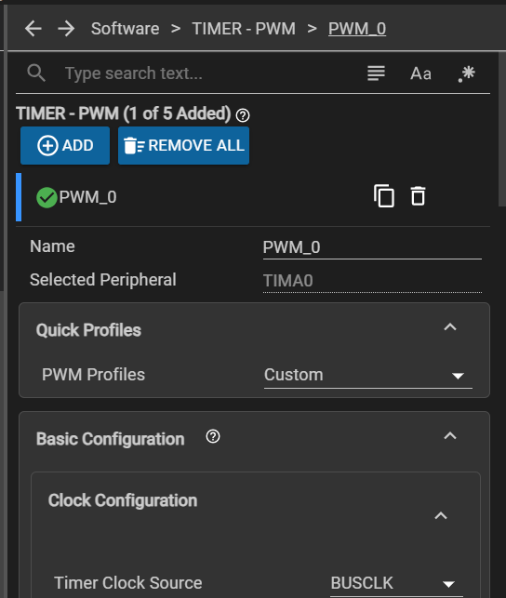
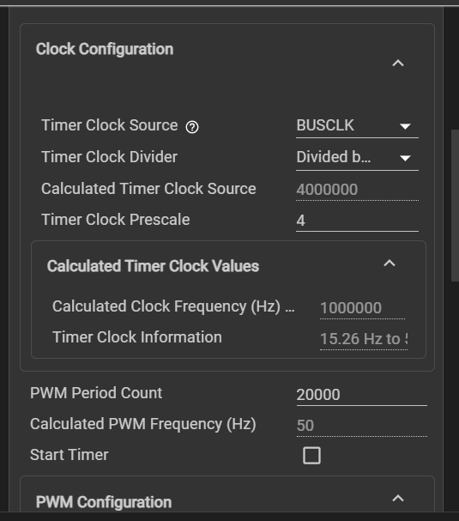
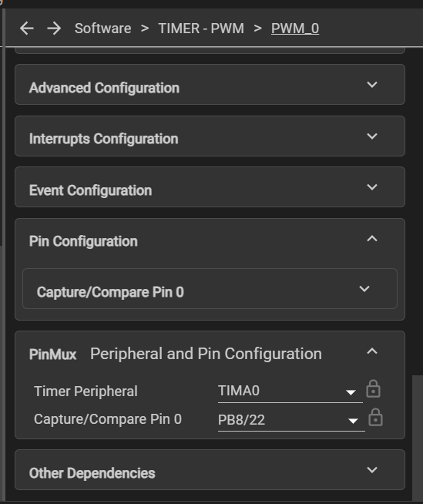
System configuration :

Slide 19
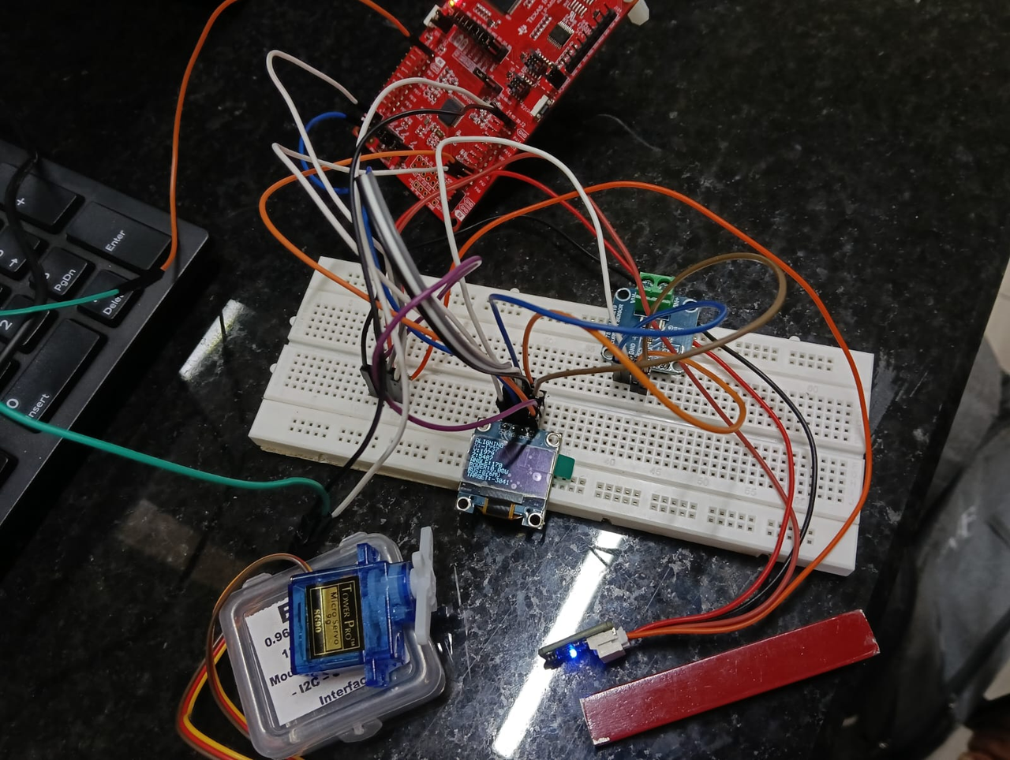
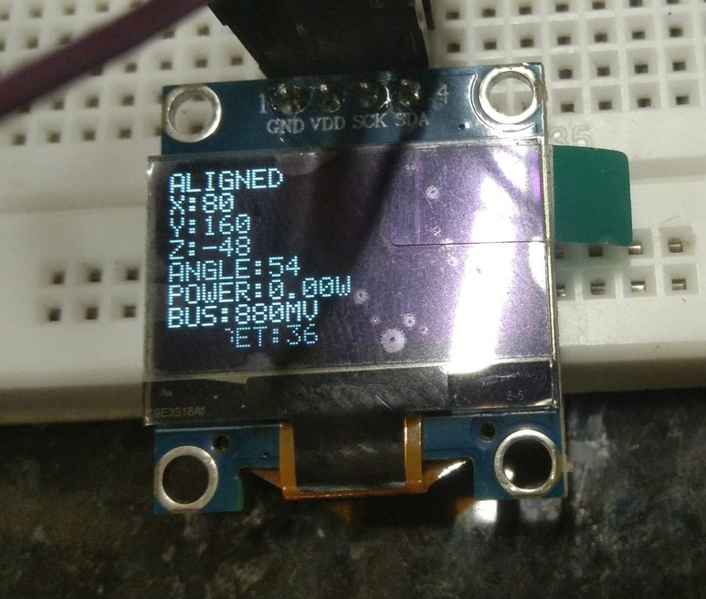
OUTPUT :

Slide 20
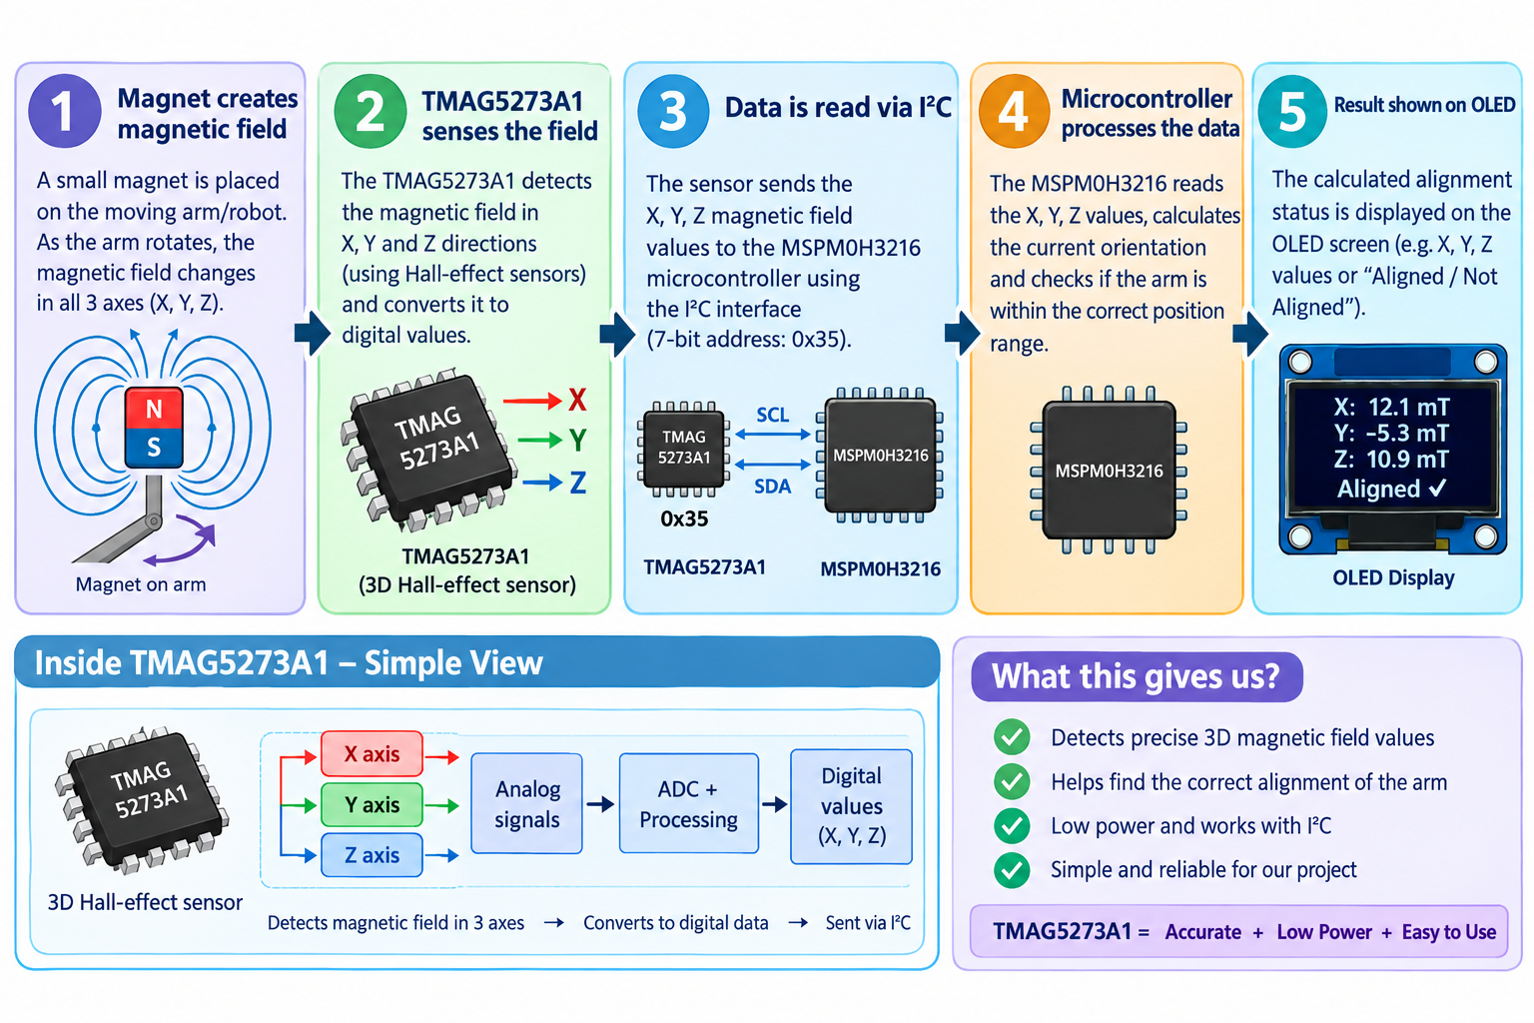
Working of Project
Notes:
1.7.2013
‹#›

Slide 21

certificates !!

Slide 22

certificates !!

Slide 23

Notes:
1.7.2013
‹#›

